Slide 1
Research of The guillotine
From: a tale of two cities
Connecting to the real world…

Slide 2
Connecting to the real world
I chose to discuss the guillotine that was mentioned in a tale of two cities. This is the main source of deaths in the novel. It is referenced as little killer in the book. Madame Defarge enjoys her front row seat watching people die at the guillotine.

Slide 3
Summary of article
Discusses guillotine as symbol of French revolution
Shared history of guillotine and how it derived—from Dr. Joseph-Ignace Guillotin
Went through eight interesting facts on the guillotine we may not have known
Gave a “did you know?” section at end about “aristocrat youths were known to throw so-called ‘victims balls’—special dances where only people who had lost an immediate family member to the guillotine were allowed to attend” (Andrews 2).
The best part was people would fake having family deaths by the guillotine to go to the ball!
(Andrews 1-3)

Slide 4
Interpretation
the main point the author wanted us to get from reading his article is there was more to the guillotine than French deaths.
Ex: scientists researched on the heads
Ex: Nazis used the guillotine during wwii
This was supposed to be informational and entertaining at the same time

Slide 5
vocabulary
Word I didn’t know…
How did I find it?
“They thought people would have limpid deaths by this machine” (Andrews 2).
Limpid means?
I looked it up on google
It means tranquil

Slide 6
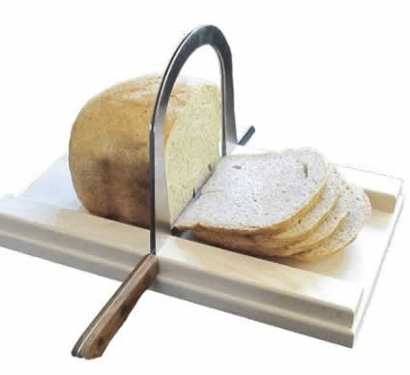
Criticism of article(s)
Agreed with…
Difficult to believe…
“Guillotine executions were major spectator events” (Andrews 2).
The idea for it came from two other devices earlier used: “planke” was used in Germany; sliding axe known as the Halifax Gibbet in england
Guillotine was made into children’s toy
Smaller versions also used as bread and veggie slicer
(Andrews 2)

Slide 7
Personal response to article(s)
I thought this piece was very entertaining and well organized
It had new information in it that I haven’t even heard of!
Organized into 8 points, which was very easy to follow

Slide 8
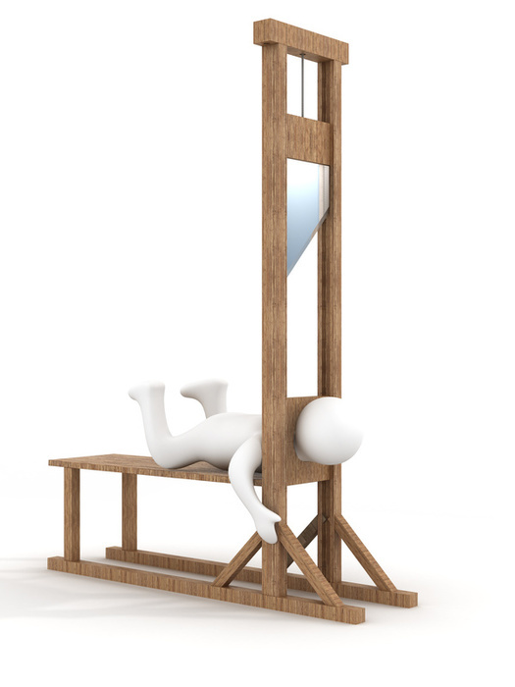
What I learned
#1: How was the idea of the guillotine thought of?
“Dr. Joseph-Ignace Guillotin proposed that the French government adopt a gentler method of execution”…what?! (Andrews 1).
(Gentler than sword or axe killing)
#2: how long was the guillotine used/Is it still used?
A: 1792-September 1981
France abolished capital punishment for good
#3: how many people died from the guillotine?
A: “tens of thousands” was the closest number I could find…(Andrews 1).

Slide 9
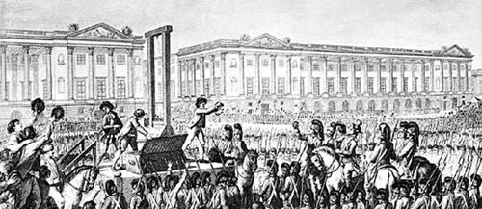
What I found most fascinating…
The guillotine was originally made to be inhumane as a quick death
The longer the guillotine was used though, the opposite beliefs were created
(Andrews 1)
In 1977 a man was killed using this!
I sure hope that blade was sharp for his sake! (sometimes the blade had to go down twice b/c it didn’t cut through all the way the first time…)
(Andrews 3)

Slide 10
Works cited
Andrews, Evan. “8 Things You May Not Know About the Guillotine.” history channel. 15 September 2014. web. 28 January 2015. http://www.history.com/news/history- lists/8-things-you-may-not-know-about-the-guillotine

Slide 11
The next time you disobey the rules, remember, your negative consequences probably aren’t that bad…: )

