Slide 1
Vocabulary-prefixes, suffixes, roots
Unit 17

Slide 2
Disreputable (adj.)
dis=???
Dis=bad
re=???
Re=again
Root=put=to think
Definition=having a bad reputation

Slide 3
Connotation (n.)
con=together with
When I say “rose,” what do you think about? THAT is a connotation!
root=nota=to note
Definition-noted with, an image or idea associated with a word

Slide 4
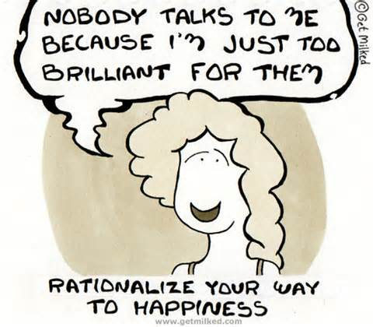
Rationalize (vb.)
No prefix
Root=ratio=reason
Definition=give reason for

Slide 5
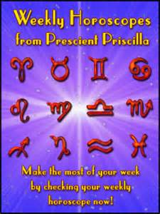
Prescient (adj.) [presh-ent]
pre=???
Pre=before, in advance
Root=sci=to know
Definition=to know in advance before something happens

Slide 6
True or false
You are far-sighted with information if you are prescient.
True
Rationalize means to put something off.
False, it means to give a reason.
An example of a connotation is when I said love, you immediately think of Valentine’s Day.
True—idea is associated with a word!
All doctors should be disreputable.
False, you want your doctors to have a good reputation, not a bad one.

