Slide 1
Vocabulary-prefixes, suffixes, roots
Unit 18

Slide 2
Anesthetic (n.)
an=without
If you ever get your wisdom teeth out, be sure to get an anesthetic!
Root=aes=feeling or perception
Definition=(without feeling) a substance which causes loss of feeling

Slide 3
Antipathy (adj.)
anti=???
Anti=against
Try not to have antipathy against people, especially those you don’t know.
root=path=to feel
Definition-(feeling against) hostility or hatred

Slide 4
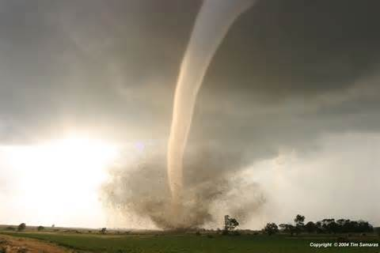
Presentiment (n.)
pre=???
Pre=before
I had a presentiment that the tornado was coming straight for us! It was in my gut!
Root=sens/sent=to feel or be aware
Definition=a feeling about something before it happens

Slide 5
Tangible (adj.)
No prefix
What are some tangible items?
The desk
The chair
My vocabulary?
Root=tang/tact=to touch
Definition=able to be grasped or touched

Slide 6
True or false
A desk is tangible.
True, because it can be touched.
A presentiment feeling could be good or bad.
True, it is simply a feeling before something happens.
Antipathy has the synonym of dislike.
True!
Anesthetic has to do with beauty or social status.
False, that is aesthetic.

