Slide 1
Vocabulary-prefixes, suffixes, roots
Unit 19

Slide 2
Inquisitive (adj.)
in=in
The boy was an inquisitive inquisitor! He had lots of questions to ask!
Root=quis=ask, seek, demand
Definition=seeking into, curious, ask many questions

Slide 3
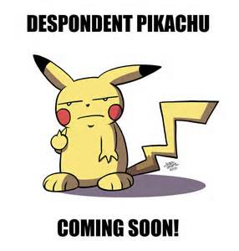
Despondent (adj.)
de=down
root=spond/spouse=pledge, show support for
Definition—less support, lacking all hope

Slide 4
Abrogate (vb.)
ab=away, from
"a proposal to abrogate temporarily the right to strike"
Root=rog=to ask, demand (usually law)
Definition=demand away; to cancel, repeal, or overturn

Slide 5
Deprecate (vb.)
de=off or away
She deprecated the idea of television for her children and did not let them watch it.
Root=prec=prayer
Definition=to pray away from, show disapproval of

Slide 6
True or false
An antonym for inquisitive is “uninterested.”
True
When Lea lost her job, she became despondent. Does this sentence work?
Yes
Abrogate means insulting or degrading.
No
A synonym for deprecate is praise.
No

