Slide 1
Vocabulary-prefixes, suffixes, roots
Unit 20

Slide 2
Premonition (n.)
pre=before
“I had a premonition! It just came to me to run out of there!”
Root=mon=to warn
Definition=a warning of something before it happens

Slide 3
Reconcile (vb.)
re=back
The court needs to reconcile and come back together to make an agreement.
root=consil=bring together
Definition—to bring back together in agreement

Slide 4
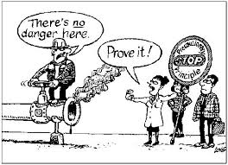
Precaution (n.)
pre=???
Pre=before
Root=caut=to be careful
Definition=an action taken against danger before it might happen

Slide 5
Dissuade (vb.)
dis=???
dis=not
Don’t try to dissuade me against getting this car…I’m doing it!
Root=suad=advise
Definition=to advise one not to do something

Slide 6
QUIZ ON FRIDAY!

