Slide 1
Vocabulary-prefixes, suffixes, roots
Unit 21

Slide 2
Gusto (n)
No prefix
I love the gusto you have about English class today!
Root=gust=taste
Definition=enthusiastic enjoyment

Slide 3
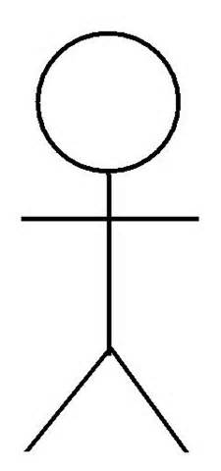
Insipid (adj.)
in=not
Why is this stick figure considered insipid?
root=sip/sap=to taste
Definition—having no taste, dull, uninteresting

Slide 4
Avid (adj.)
No prefix
Some avid students can get college done in three or less years.
Root=av=to crave or desire
Definition=enthusiastic or eager

Slide 5
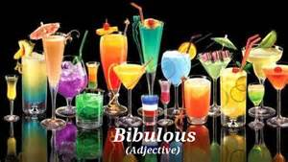
Bibulous (adj.) [bi-byu-les]
Suffix=-ous=full of
Definition=drunken
Root=bib=to drink

Slide 6
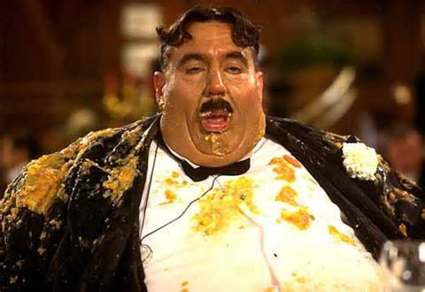
Glutton (n)
No prefix
Root=glut=to devour
Definition=one who wants or takes too much, especially food or drink

Slide 7
Palatable (adj.)
Root=palat=palate
The assignment was palatable, but nothing more than that.
Suffix=-able=having the ability
Definition=acceptable, satisfactory

Slide 8
Review: matching
Palatable___
Glutton___
Bibulous___
Avid___
Insipid___
Gusto___
Having no taste
One who wants too much food
Acceptable
Enthusiastic enjoyment
Drunken
Enthusiastic or eager

