Slide 1
Vocabulary-prefixes, suffixes, roots
Unit 22

Slide 2
Pantograph (n.)
Prefix=pan/panto=???
pan/panto=all
Root=graph=something drawn or written
Definition=instrument to mechanically copy all of something drawn or written

Slide 3
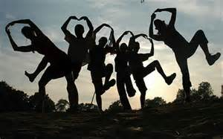
Orthodox (adj.)
No prefix
root=ortho=straight, correct
Definition—conforming to correct beliefs

Slide 4
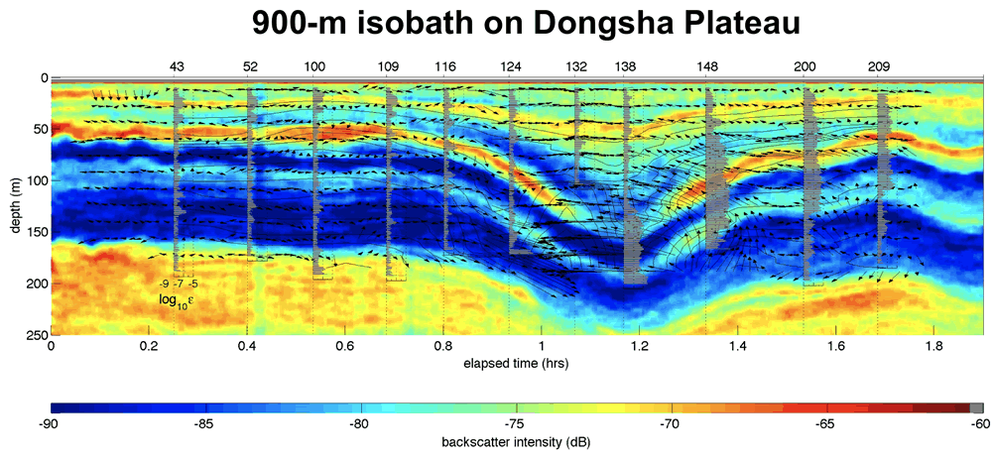
Isobath (n.)
Prefix=iso=equal
Root=bath=water depths
Definition=line connecting equal water depths

Slide 5
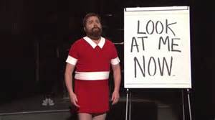
monologue (n.)
Prefix=mono=???
Mono=one
Root=log=word or speech
Definition=speech spoken by one person

Slide 6
QUIZ ON FRIDAY!!!

