Slide 1
Vocabulary-prefixes, suffixes, roots
Unit 23

Slide 2
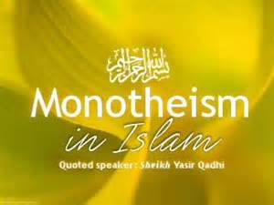
Monotheist (n.)
Prefix=mono=???
Root=theo=God
Definition=belief in only one god

Slide 3
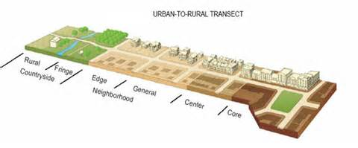
transect (vb.)
Prefix=tran=across
Root=sect=cut
Think of the word dissect
Definition=to cut across

Slide 4
Petrology (n.)
Prefix=petro=rocks
Suffix=logy=study of
Definition=study of rocks

Slide 5
Chronicle (n.)
No prefix
Think about the movie The Chronicles of Narnia…this is ___ of the land of Narnia.
history
Root=chron=time
Definition=record of events over time; history

Slide 6
Review: Fill in the sentences: petrology, monotheist, chronicle, transect
I am going to create a ___ of my life.
chronicle
___ is the study of rocks.
petrology
When I dissect the frog, eventually I will make a ___ cut across the stomach.
transect
If you believe in Zeus and Zeus only, then you are a ___.
monotheist

