Slide 1
Vocabulary-prefixes, suffixes, roots
Unit 24

Slide 2
Polyethnic (adj.)
Prefix=poly=many
Root=ethnic=group of people
Definition=consisting of people with many ethnic backgrounds

Slide 3
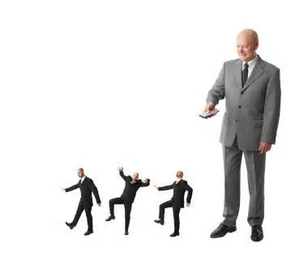
Autocrat (n.)
Prefix=auto=self
EX: autocratic leadership
Root=krat=power
Definition=absolute monarch in power

Slide 4
Telepath (n.)
Prefix=tele=distance
Telepathy is the communication between minds.
Suffix=path=connection or feeling
Definition=one who can make distant connections

Slide 5
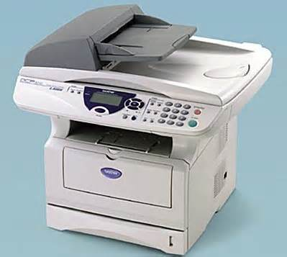
Chromograph (n.)
Root=chrom=color
Suffix=graph=to write
Definition=device which makes copies

Slide 6
QUIZ ON FRIDAY!

