Slide 1
Vocabulary-prefixes, suffixes, roots
Unit 25

Slide 2
Bibliomaniac (n.)
Root=biblio=book
Suffix=mania=extreme desire for
Definition=one extremely obsessed with possessing books

Slide 3
Mobocracy (n.)
Root=mob=lawless people
Connector=“o”
Suffix=cracy=governing body
Definition=political control by a mob

Slide 4
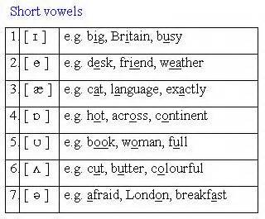
Phonetic (adj.)
Root=phon=sound
Suffix=-ic=makes it an adjective, giving it characteristics of something
Definition=agreeing with sound or pronunciation

Slide 5
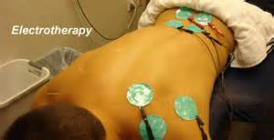
Electrotherapy (N.)
Prefix=electro=electricity
Root=therap=treatment
Definition=treatment of diseases by using electricity
This used to be used in the old days…
Today it’s used in small dosages.

Slide 6
Fill in the sentences: bibliomaniac, electrotherapy, mobocracy, phonetic
1. If you were known to have a disease back in the old days, they would use ___ on you to get rid of it.
electrotherapy
2. When words rhyme, they have ___ similarities.
phonetic
3. Librarians may be known as ___ because they are obsessed with books!
bibliomaniacs
4. Al Capone was the leader of a ___, doing things the illegal ways.
mobocracy

