Slide 1
Vocabulary-prefixes, suffixes, roots
Unit 26

Slide 2
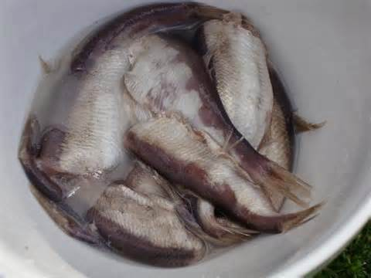
Rancid (adj)
Root=ranc=to stink
No suffix…
Definition=rotten or spoiled

Slide 3
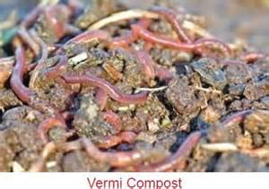
Putrefy (vb)
Root=putr=rotten
No suffix
Definition=to rot or decompose

Slide 4
Stagnate (vb.)
Root=stagn=to stand, or form a pool of standing water
No suffix
Definition=to stop moving or growing in an unhealthy way

Slide 5
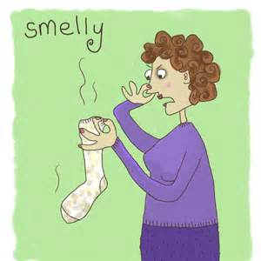
Odoriferous (adj.)
Root=odor=smell
Suffix=ferre=to carry
Definition=carrying around a smell

Slide 6
QUIZ ON FRIDAY!!!

