Slide 1
Vocabulary-prefixes, suffixes, roots
Unit 28

Slide 2
Infraction (n.)
in=intensifier
If you have a fracture, your bone is broken.
Root=fract=to break
Definition=minor violation of breaking the law

Slide 3
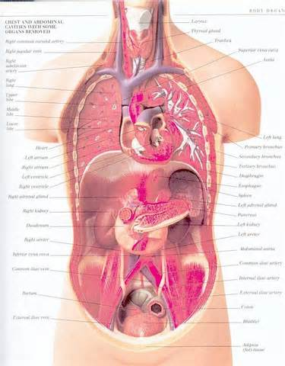
Anatomy (n.)
Prefix=ana=up
Root=tom=to cut
Definition=the structure or parts cut up

Slide 4
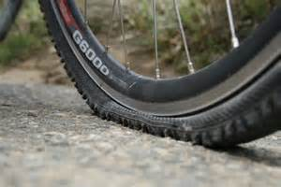
Puncture (n.)
Root=punct=to sting or pierce
-ure=abstract noun suffix (usually telling an action)
Definition=a hole or mark made, piercing

Slide 5
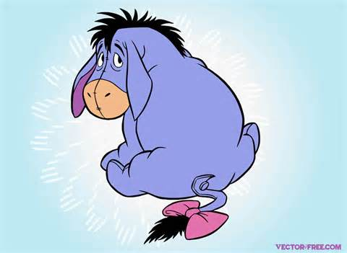
Dejected (adj.)
de=down
If you are ejected, you are thrown…
Eeyore is a
typical dejected
character…
Root=ject=to throw
Definition=to have down feelings; depressed

Slide 6
QUIZ ON FRIDAY!

