Slide 1
Vocabulary-prefixes, suffixes, roots
Unit 30

Slide 2
Ingrate (n.)
in=not
You should leave a 15% gratuity at restaurants because you are thankful for the waitress’ hard work.
If you are grateful, you are thankful.
Root=grat=thankful
Definition=one who is not properly thankful

Slide 3
Revolution (n.)
re=back
Revolutions can sometimes cause the times of life to go backwards.
Root=volu/volv=to turn
Definition=a sudden turning over, often violent

Slide 4
Inflection (n.)
in=in
Inflection is needed to be successful in persuasive speeches.
“I feel that this school MUST change the lunch program!”
Root=flex/flect=to bend
Definition=to bend in, or change pitch/tone of voice

Slide 5
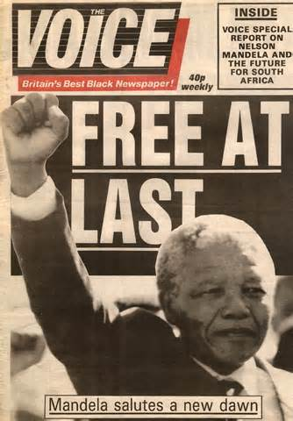
Decriminalize (vb.)
de=away
Root=crimin=charge of crime; crime
Definition=to take away the charge of a crime

Slide 6
QUIZ ON FRIDAY!

