Slide 1
Vocabulary-prefixes, suffixes, roots
Unit 31

Slide 2
Fallacy (n.)
In speech, fallacies are used in persuasive speeches, which make the sources incredible.
Root=fall=to deceive
Definition=a deceiving or misleading idea

Slide 3
Credence (n.) [kree-dens]
If you are credible, you are trustworthy and believable.
Should we have credence in wikipedia.org?
Root=cred=to trust, believe
Definition=trust or belief

Slide 4
Definitive (adj.)
de=from
If something is definitive, it needs to be certain.
“You must have a definitive answer before shouting out.”
Root=fin=end, border, limit
Definition=from limits, standard and for sure

Slide 5
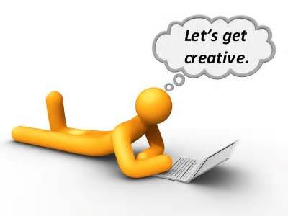
Innovative (adj.)
in=intensifier
Root=nov=new
Definition=showing very new creativity and originality

Slide 6
Vocab Review: innovative, definitive, credence, fallacy
Hopefully for your project you can come up with a(n) ___ idea.
Innovative
Please don’t add any ___ to your presentation; keep it truthful.
Fallacies
Find a ___ website for your source.
Credence
All facts on the project must be ___.
Definitive

