Slide 1
Vocabulary-prefixes, suffixes, roots
Unit 32

Slide 2
Primitive (adj.)
The Hominidae; also known as great apes form a taxonomic family of primates, including four categories:
chimpanzees
gorillas
humans
orangutans
Root=prim=first
Definition=being the first or earliest of the kind

Slide 3
Degrade (vb.)
De=down
“Do not degrade me! I am just as smart as you and take that offensively!”
Root=grad/gress=to go forth, progress
Definition=to progress one’s feelings down, insult

Slide 4
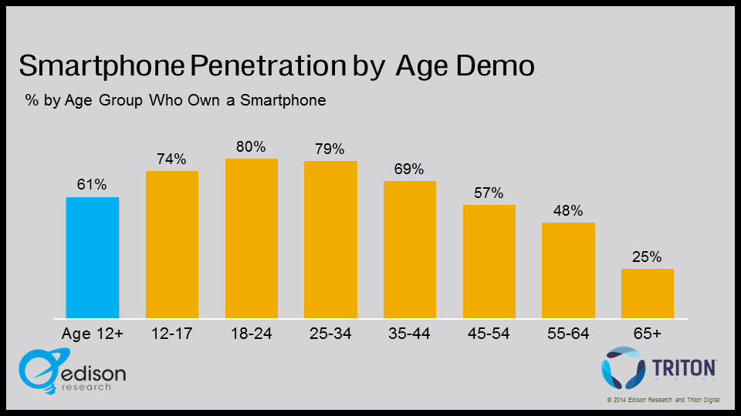
Demographics (adj.)
Root=dem=people
This occurs when people have certain qualities in common: race, gender, age, etc.
graphy=study of
Definition=study of people, noticing certain characteristics in common

Slide 5
Cosmopolitan (adj.)
Prefix=cosmos=world
No I am not talking about the magazine Cosmopolitan!
Root=polit=city
Remember, politics first started in a city
Definition=being a citizen of the world; sophisticated

Slide 6
QUIZ ON FRIDAY~

