Slide 1
Vocabulary-prefixes, suffixes, roots
Unit 33

Slide 2
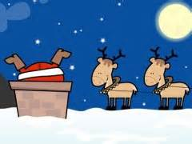
Clamorous (adj.)
Santa made a clamor on the rooftop.
Root=clam/claim=to shout or call
Definition=being loud or noisy

Slide 3
Acrimonious (adj.)
Root=acri=sharp
Do you remember what acrid means?
Answer: sharp odor or taste
moni(y)=quality of
Definition=having a sharp bitter quality in speech or mood
An acrimonious debate between the two candidates heated up.

Slide 4
Irrational (adj.)
ir=in=not
“You are being irrational!”
Irrational numbers are those that cannot be written as a fraction or decimal.
Root=ratio=reason
Definition=not having reason or logic

Slide 5
Annotations (n.)
an=ad=towards
These usually include footnotes or end notes.
Root=nota=to note
Definition=notes towards a body of writing to explain

Slide 6
Vocab Review: annotation, irrational, acrimonious, clamorous
This type of thinking does not have logic behind it: ___.
Irrational
Banging pots and pans together would for this type of noise: ___.
Clamorous
When things get serious in an argument, this type of speech comes out: ___.
Acrimonious
These can be notes made on someone’s written work on footnotes added: ___.
Annotation

