Slide 1
Vocabulary-prefixes, suffixes, roots
Unit 34

Slide 2
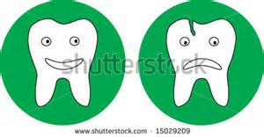
Intact (adj.)
in=not
Which tooth is still intact?
Root=tang/tact=to touch
Definition=not touched; unbroken or whole

Slide 3
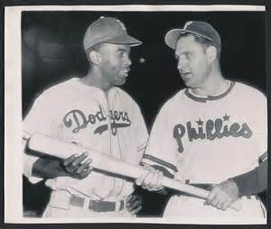
Conciliatory (adj.)
With a conciliatory gesture…
Jackie Robinson and Ben Chapman
Root=consil=bring together or advise
Definition=bring together to lessen another’s anger

Slide 4
Cautionary (adj.)
The policeman told us a cautionary story about drunk driving.
Root=caut=to be careful
Definition=intended to serve as a warning

Slide 5
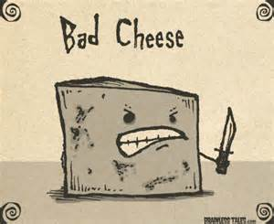
Malodorous (adj.)
mal=???
mal=bad
Malodorous cheese
Root=odor=smell
Definition=bad smelling

Slide 6
QUIZ ON FRIDAY!

